Slide 1

Charts Assignment
David Berberena
DSC 640 Data Presentation and Visualization
Weeks 1 and 2
6/16/24

Slide 2
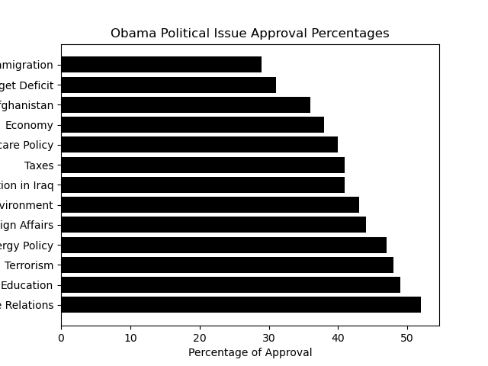
Python Bar Chart

Slide 3
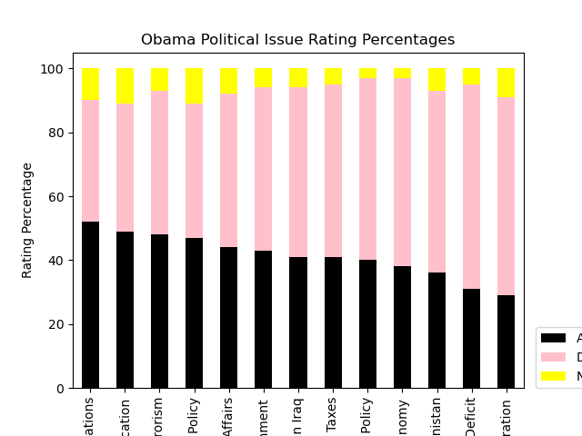
Python Stacked Bar Chart

Slide 4
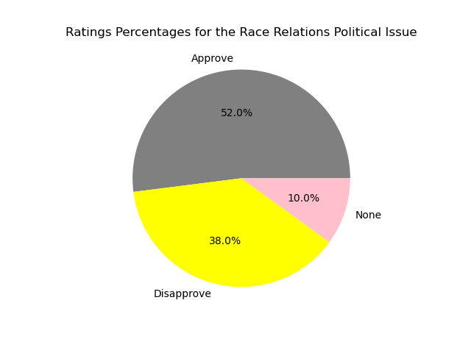
Python Pie Chart

Slide 5
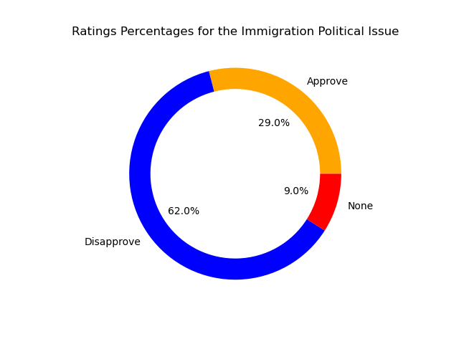
Python Donut Chart

Slide 6
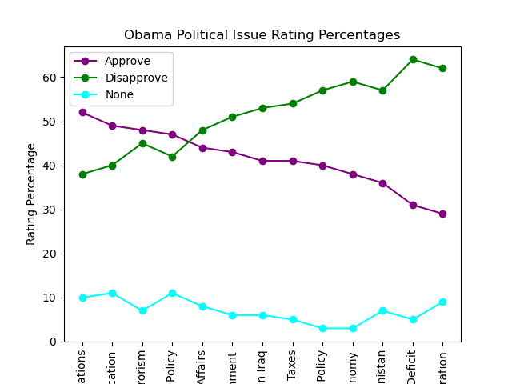
Python Line Chart

Slide 7
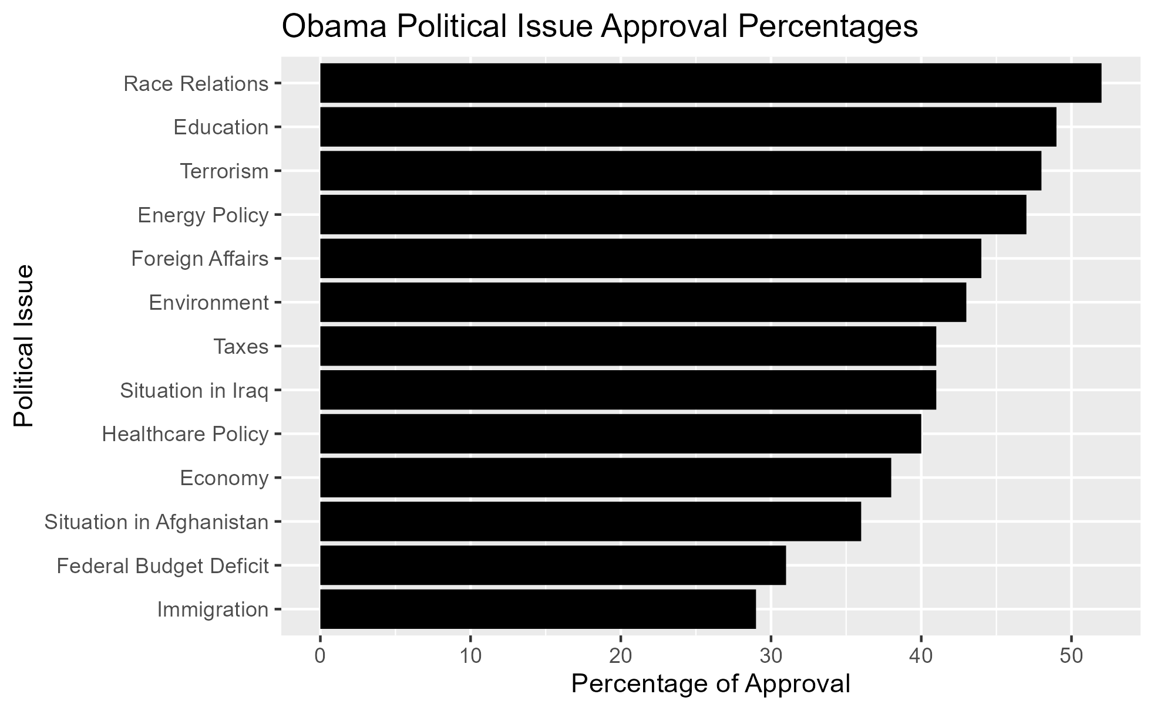
R Bar Chart

Slide 8
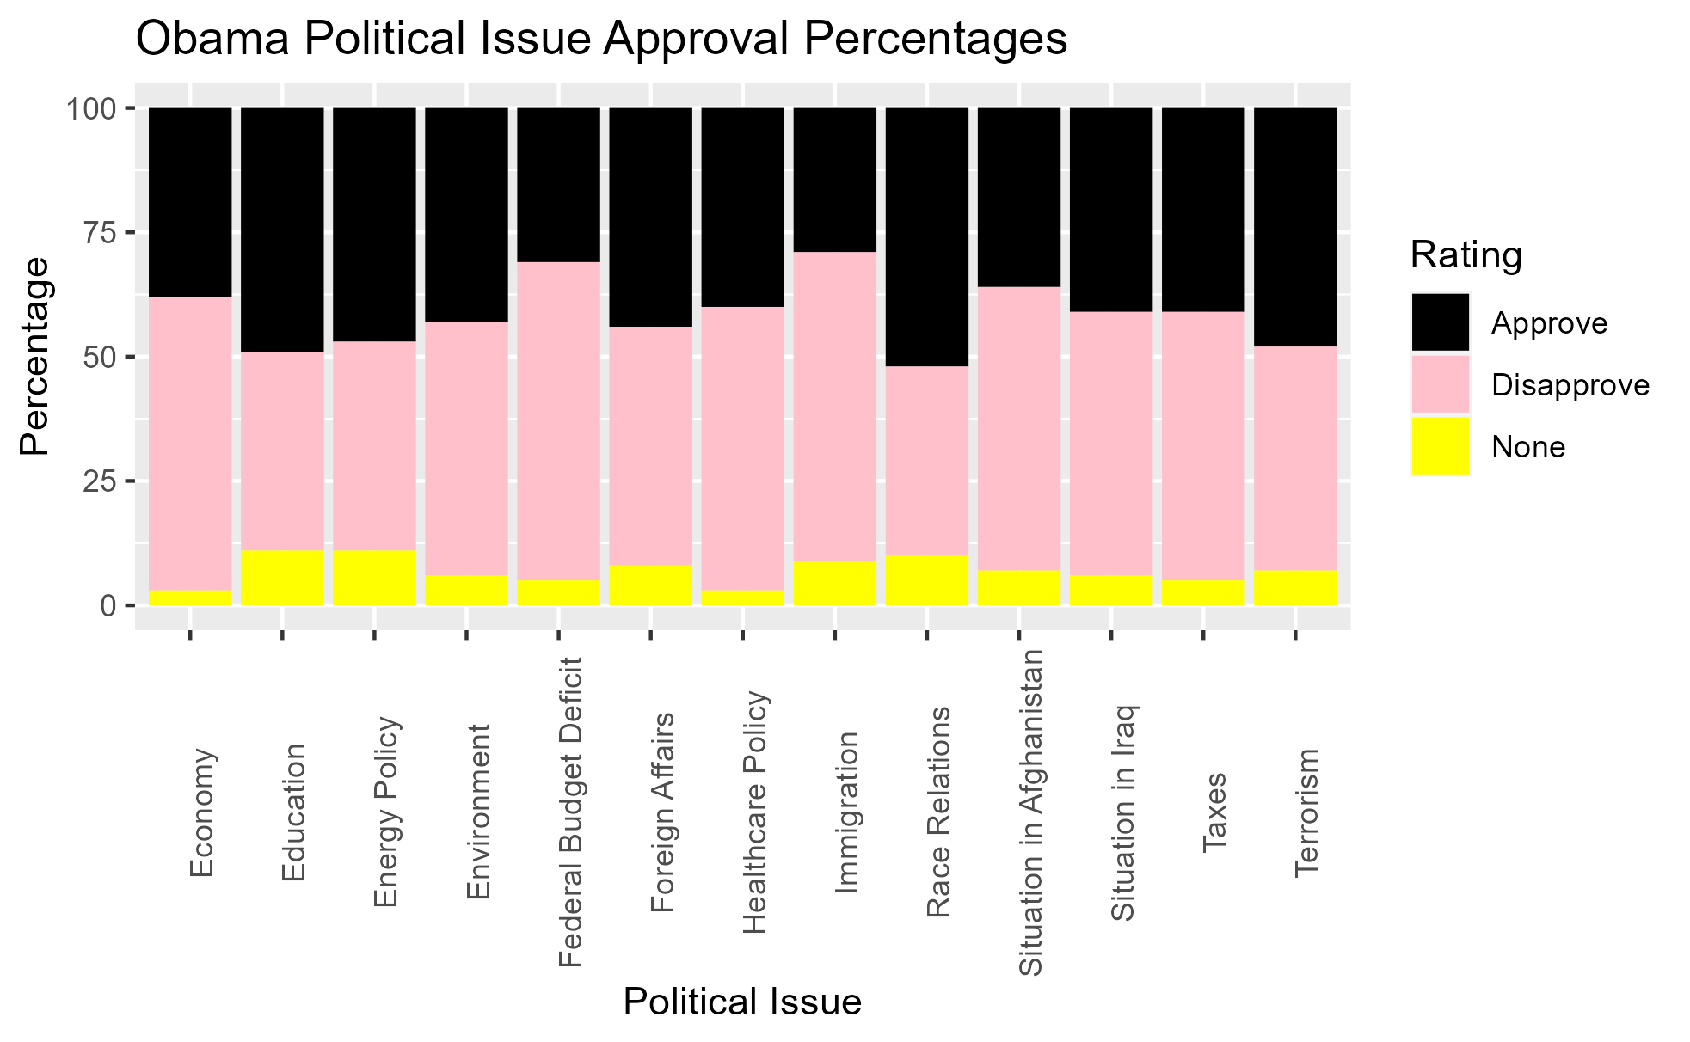
R Stacked Bar Chart

Slide 9
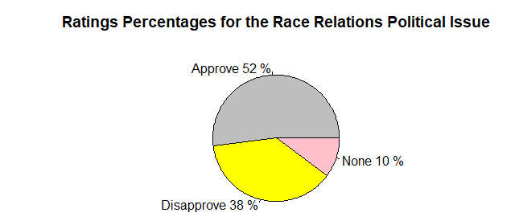
R Pie Chart

Slide 10
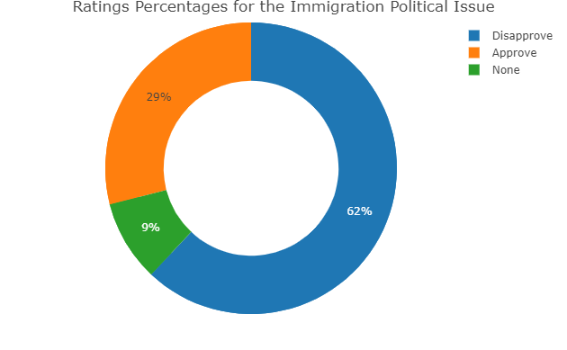
R Donut Chart

Slide 11
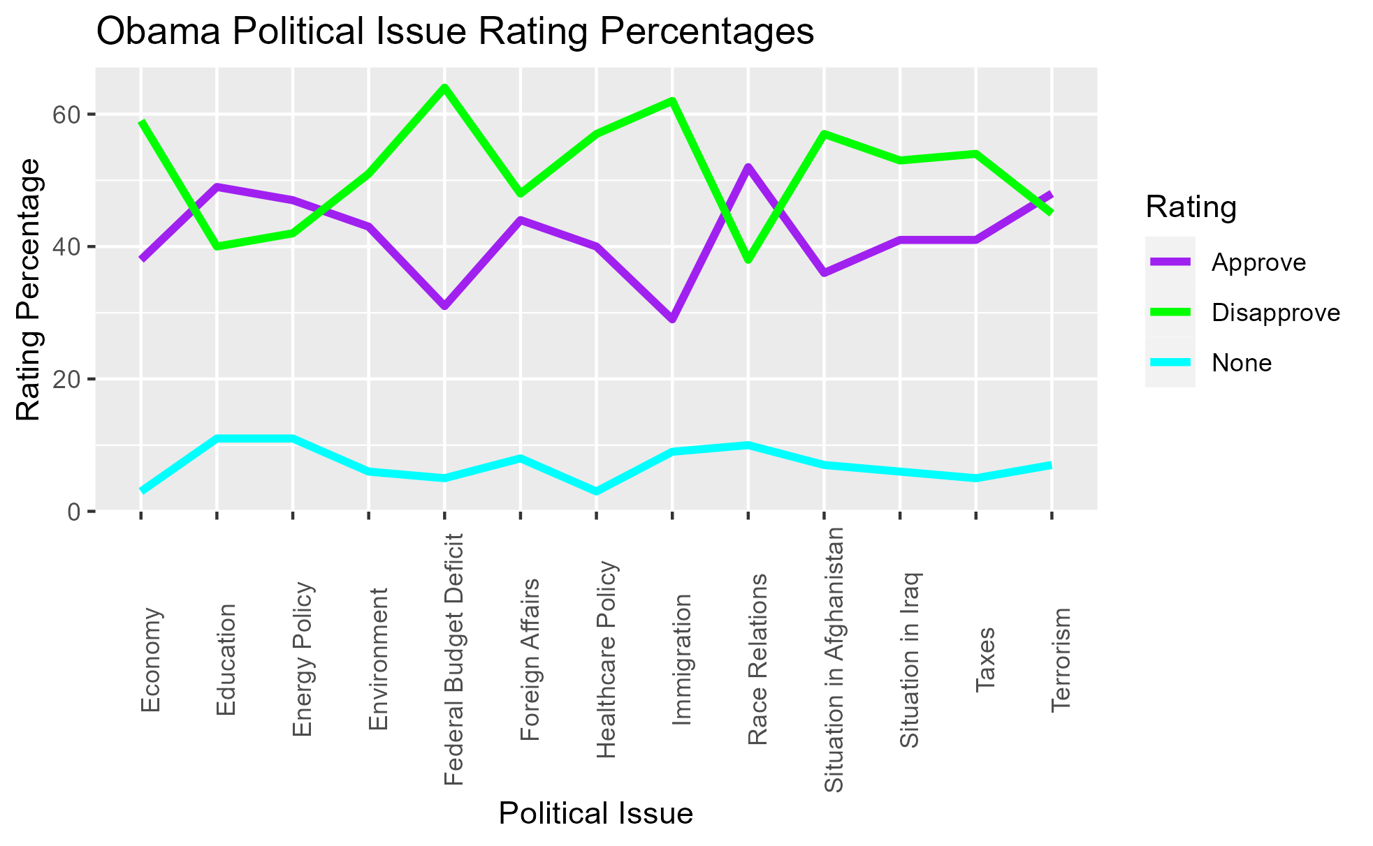
R Line Chart

Slide 12
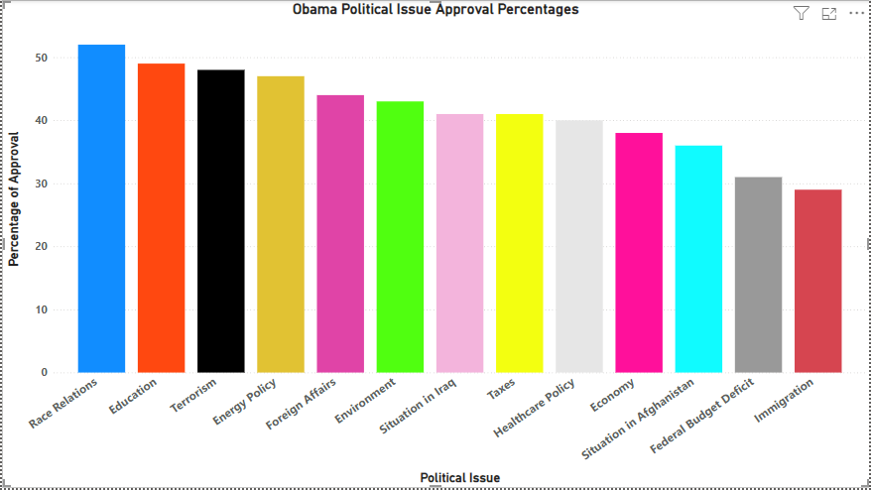
PowerBI Bar Chart

Slide 13
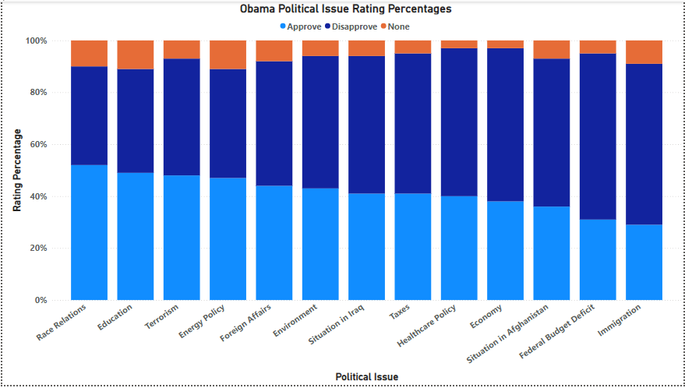
PowerBI Stacked Bar Chart

Slide 14
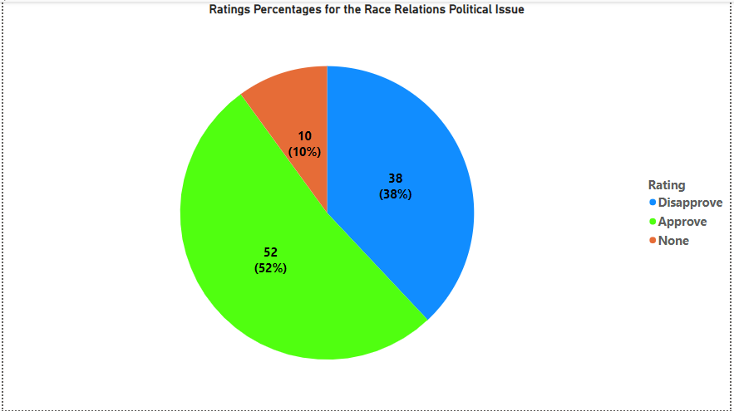
PowerBI Pie Chart

Slide 15
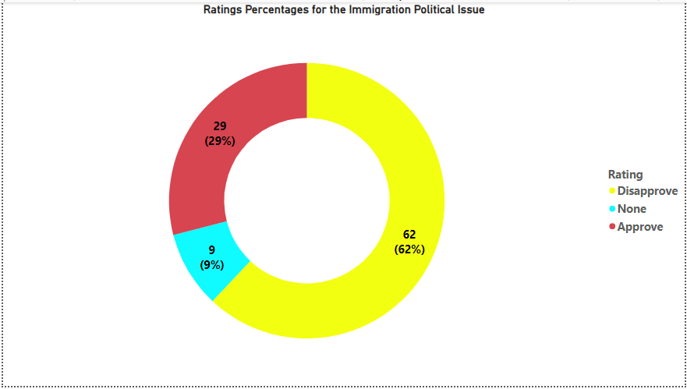
PowerBI Donut Chart

Slide 16
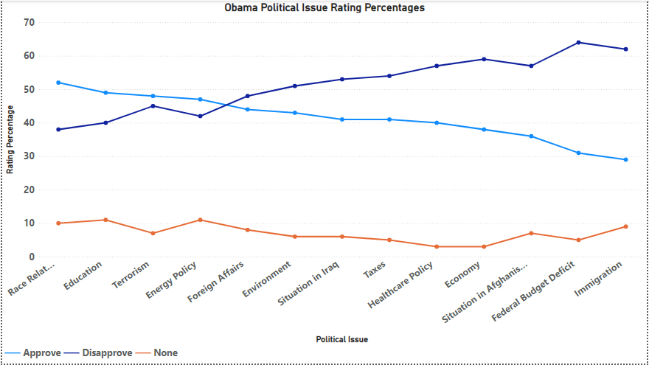
PowerBI Line Chart

